Slide 1
ENSE 374, Milestone 2
[Group 11]
Yash
Nick
Rabaa
[Oct 23rd 2019]

Slide 2
Project blurb & MVC architecture
Reminder:
An MVC application website works on connecting all election candidates with the community and vice versa.

Slide 3
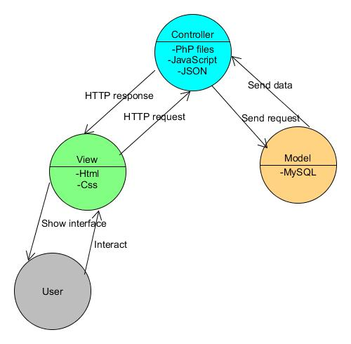
MVC

Slide 4
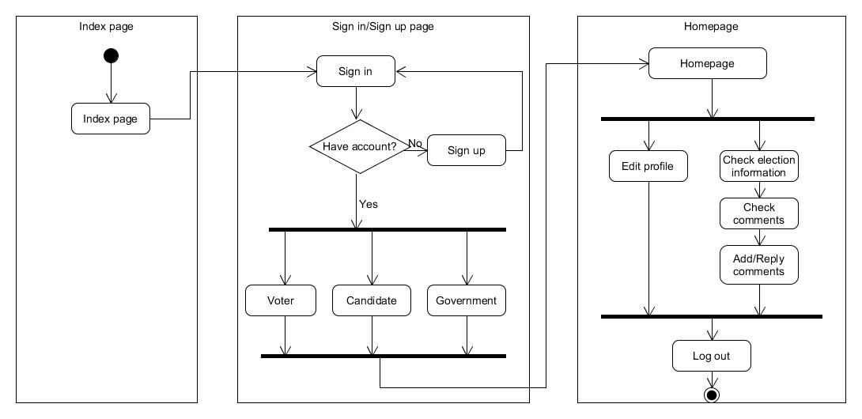
Domain Driven Design, UMLing, & MVP-1

Slide 5
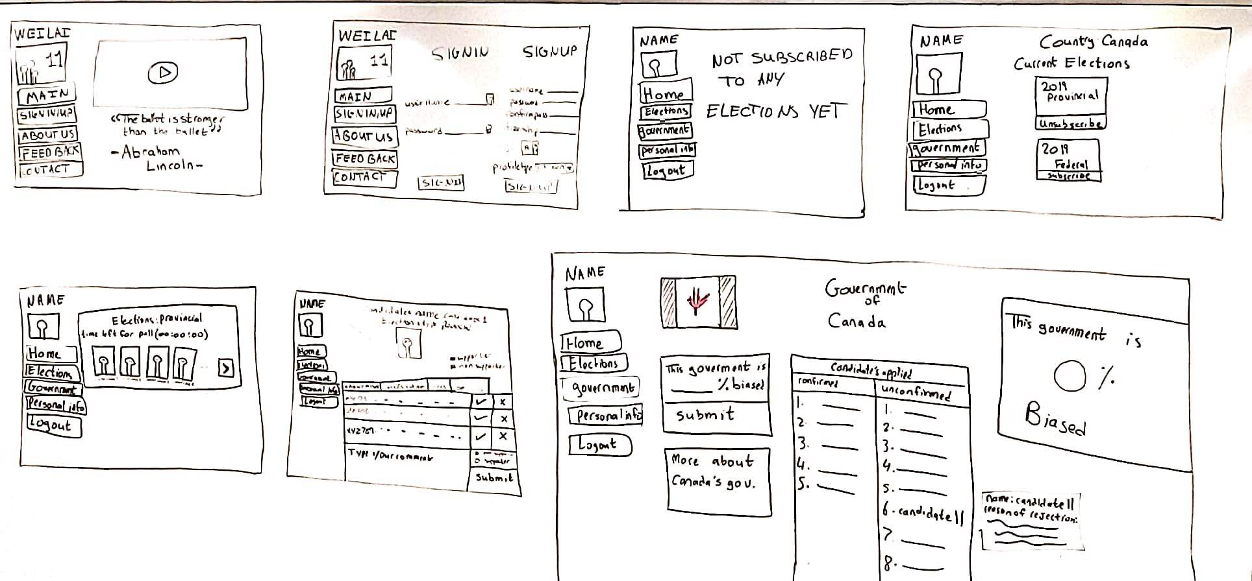
Lo-fidelity prototype
Display and discuss your team’s lo-fidelity prototype
  Describe key activities and interaction flow

Slide 6
Requirements, Kanban & GitHub review
Illustrate, quickly go over, your team’s evolved requirements document
  [Updated FRD and updated MVC diagrams]
Any other changes in your project from your team’s last presentation?
  [We have added more features to our website that should indicate how biased the admin is.]
Illustrate your updated Kanban (in GitHub)
    https://github.com/Nick-liu666/374group-project/projects/3
    envisioned barriers:
    - Limitation of the governmental actions on the website.

Slide 7
Group reflection
How did you feel about this milestone? What did you like about it? What did you dislike?
  [This milestone has helped us to have a better idea on our website will look like.For the dislikes, we are at an early stage of the project and there is a possibility for our initial diagrams to change at the later phases of our project. ]
What did you learn about yourself as you collaborated and worked through this milestone?
  [We learned that Nick here is good at the back-end server-side programming of the website, whereas Yash and Rabaa will be working on the client-side of the website.]
How will you use wyou hat we will have learned going forward?
  [From what we have learned so far, be trying to make our website more domain driven.]

